Slide 1

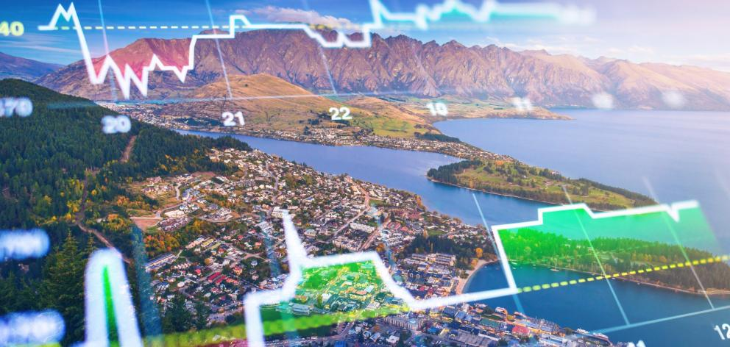

Team Asclepius
Insight into New Zealand Economy
- A data science approach
Notes:
New Zealand is a relatively small economical entity that heavily rely on overseas business. Facing an increasing turbulent international political and economical environment (war and covid-19), in order to maintain our prosperity, in depth analysis on how New Zealand vital economical policy impact on our main economical activities are not only useful but also crucial for the success of these New Zealand companies, such as Air NewZealand, Kiwi Rail and Tourism New Zealand.

Slide 2
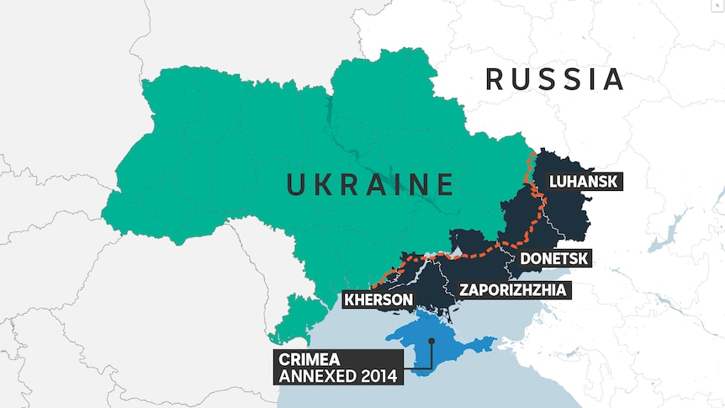

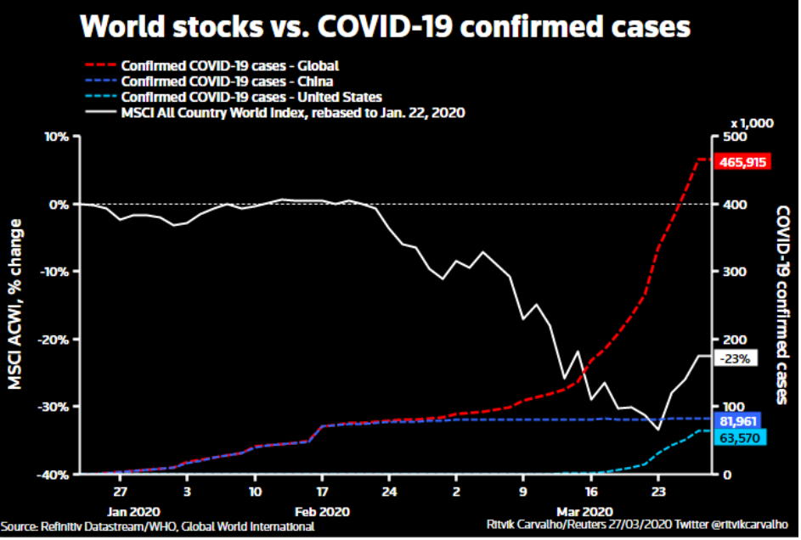
Background
Turbluent International Market caused by political uneasying and COVID-19
Notes:
1) The China–United States trade war is an ongoing economic conflict between the People's Republic of China and the United States of America.
2) The Russo-Ukrainian War has been ongoing between Russia and Ukraine since February 2014. Hostilities were initiated by Russia shortly after Ukraine's Revolution of Dignity and were focused on the political status of Crimea and the Donbas, which remain internationally recognized as part of Ukraine.
3) The COVID-19 pandemic, also known as the coronavirus pandemic, is an ongoing global pandemic of coronavirus disease 2019 (COVID-19) caused by severe acute respiratory syndrome coronavirus 2 (SARS-CoV-2). The novel virus was first identified from an outbreak in Wuhan, China, in December 2019.

Slide 3

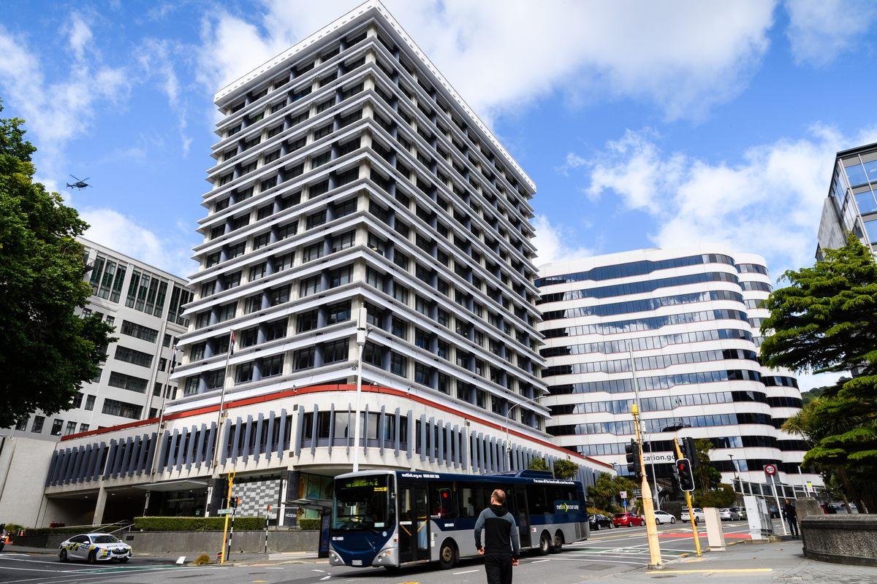
NZ monteary policy impacting the economic
Using reserve bank interest rate / official cash rate
CPI...
Stimulate the economy
Notes:
By adjusting short-term interest rates central banks can affect short-term economic growth. Low interest rates encourage business investment and consumption, while high interest rates induce saving and reduce consumption.
So, NZ central bank would try to "low interest rates" to encourage business investment and consumption, thus Stimulate NZ economy.

Slide 4
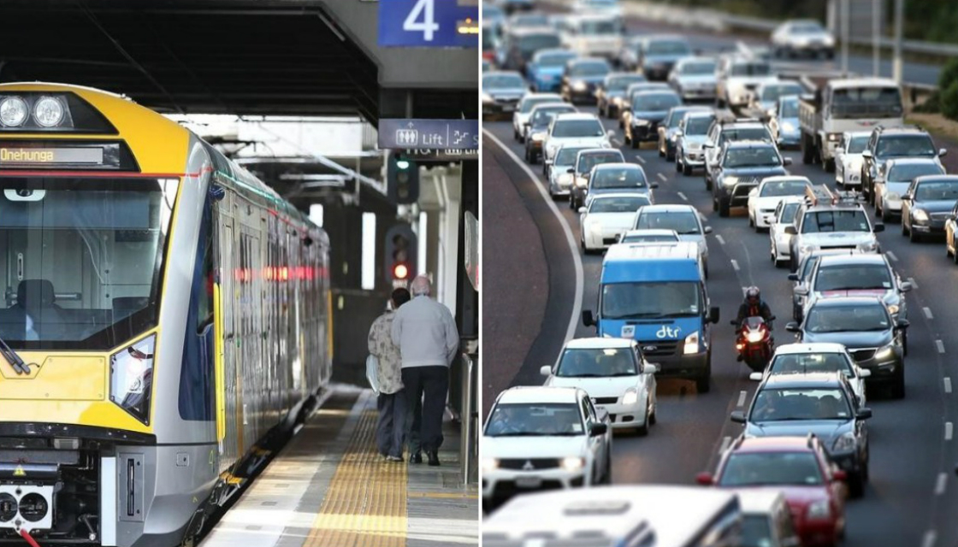

What do we want to collect
https://chartingtransport.com/category/new-zealand-cities/
Historical economical activity data for New Zeland
Employment / Unemployment Rate
Economical policy data of New Zealand Government
Interest rate
CPI
HPI (optional)
Exchange Rate
Notes:
New Zealand govt release policy indictors : 1) Interest rate 2) CPI 3) Exchange Rate 4) Employment Statistics 5) Transportation Statistics

Slide 5
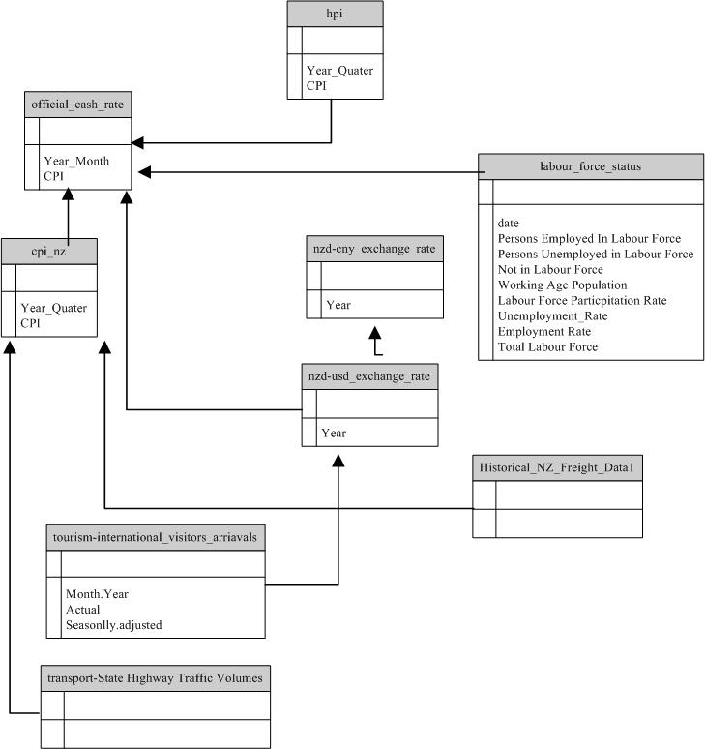
Data model
Official cash rate / Interest rate
Monetary policy influences economic activity by changing the incentives for saving and investment. This channel typically affects consumption, housing investment and business investment. Lower interest rates on bank deposits reduce the incentives households have to save their money.
In our project, we choose “Reserve bank Interest Rate” as primary monetar policy indicators

Slide 6
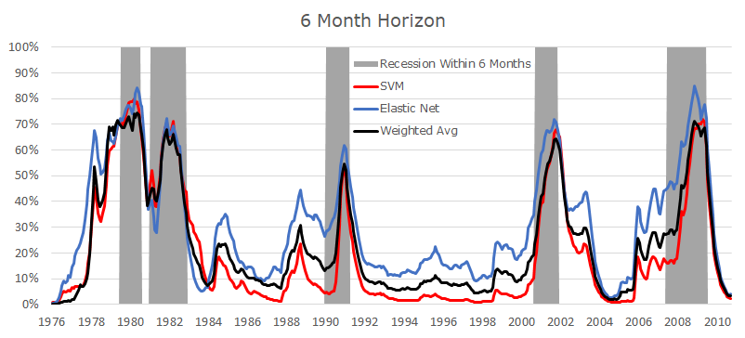

What target you chose (I.e.n what is the intended use of the data, …)
Review of the hisotrical economic performance VS. policy
1) Our target is to produce a well structured New Zealand economic dataset
Critical review of the NZ monetary policy effectiveness.
2) Potential usage :
The data source we are building is intended to be used for building (visualization) and training prediction model (machine learning) time series, forecasting for New Zealand companies.
The potential user of our datasource are targeted to improve their company agility in the current turbulent market.
By analyzing company performance data such as Annual Income VS historical transportation statistics VS. New Zealand Government monetary policy data such as CPI, Exchange Rate, Import Taxation.
Notes:
AI is particularly helpful in corporate finance as it can better predict and assess loan risks. For companies looking to increase their value, AI technologies such as machine learning can help improve loan underwriting and reduce financial risk.

Slide 7
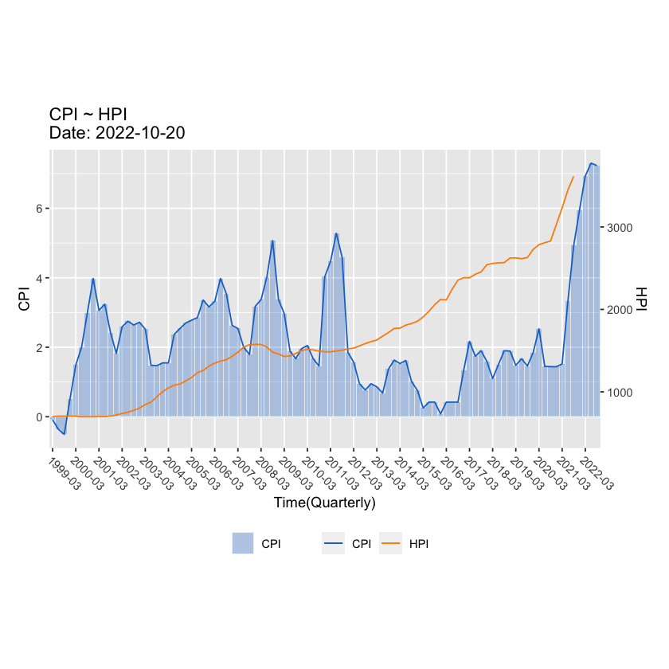
Why do we choose these data sources
To build a solid fundation for further data analysis
To find correlation between these data and discover insight among them

Slide 8
Resources used to get data
Data Sources used:
https://infoshare.stats.govt.nz
https://www.interest.co.nz/chart-data/get-csv-data
https://api.ofx.com/PublicSite.ApiService//SpotRateHistory/allTime/NZD/CNY

Slide 9
Techniques and tools used
Techniques used:
Browser Automation(R selenium)
Scrapping
API
Tools used for scraping and automation:
rvest
RSelenium
etc..

Slide 10
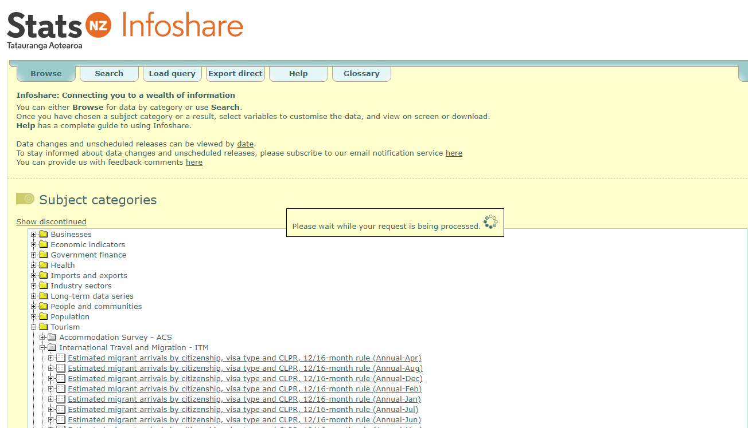
Resources used to get data
Notes:
These pages are database driven dynamic pages, so we have to be smarter for retrieving data, using “Rselenium”web driver. (Select tree and condition... all use R selenium)

Slide 11
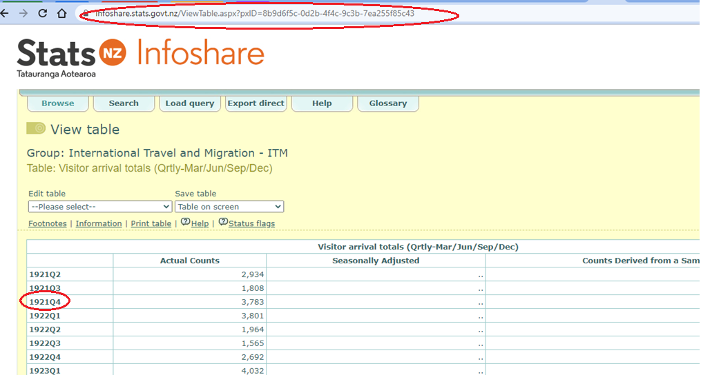
Resources used to get data
Notes:
Data Wrangling : Further detailed example, we have to wrangle 1921Q4 into 1921-12(December) by creating function that does the transformation.

Slide 12
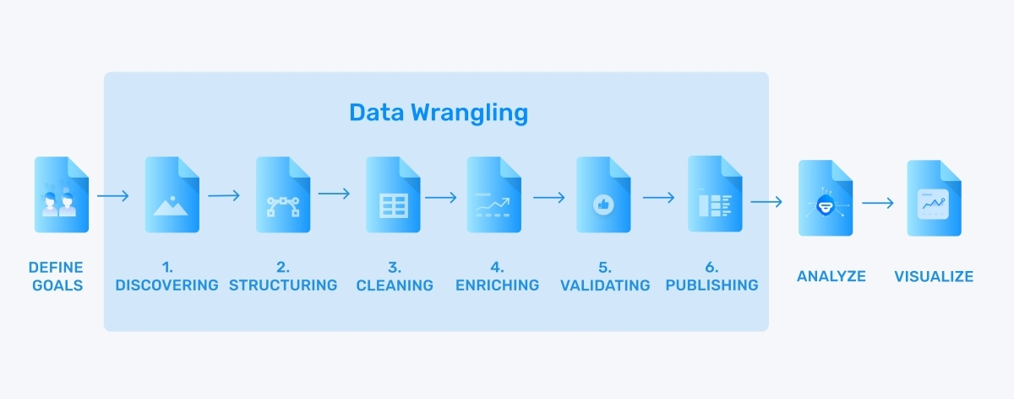
What techniques you did see
Processes applied to data before visualization:
For data scraping, various techniques have been utilized for direct data file downing, web scraping, API calling
Notes:
The process we used following steps :
First of all, we dfine our goals, secondly, we conduct discoverying data source, then we found our data is structured based on timeline.
We have enriched our dataset by scrapping more revelent data sources (some particular measures. ), with validation complete, we going to preepare data publishing by buidling rest API (In R).
The results can be demonstrated by visulization in the following section.

Slide 13
What you managed to achieve and what you failed to do
Achieved :
Data collection, data wrangling and data Visualization
To be achieved
We are aiming at deliver publishing API
Failed
We failed to download data from RBNZ web sites, as the data source is behind “Cloudflare” CDN (content delivery network)

Slide 14
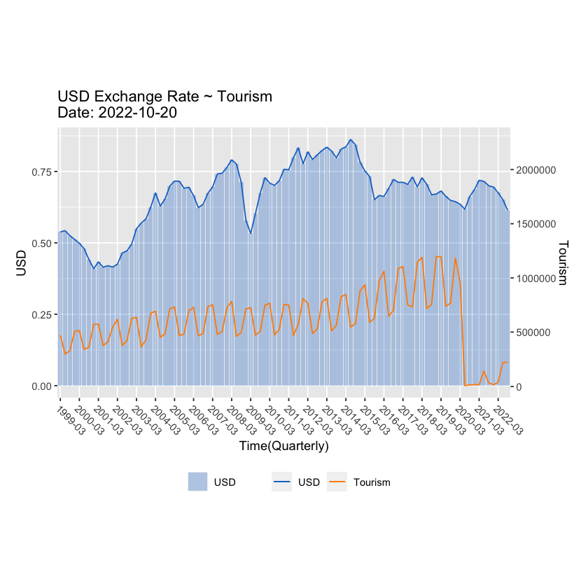
NZD USD Exchange Rate VS. Tourism
With increase of the NZDollar USdollar exchange, it is more expensive for tourism coming to New Zealand, we can observe a dropping of the “Tourism International Visitors Arrivals”
2) x axis time (yyyy-mm) : y axis (Tourism international visitors arrivals) + nzd-usd-exchange rate

Slide 15
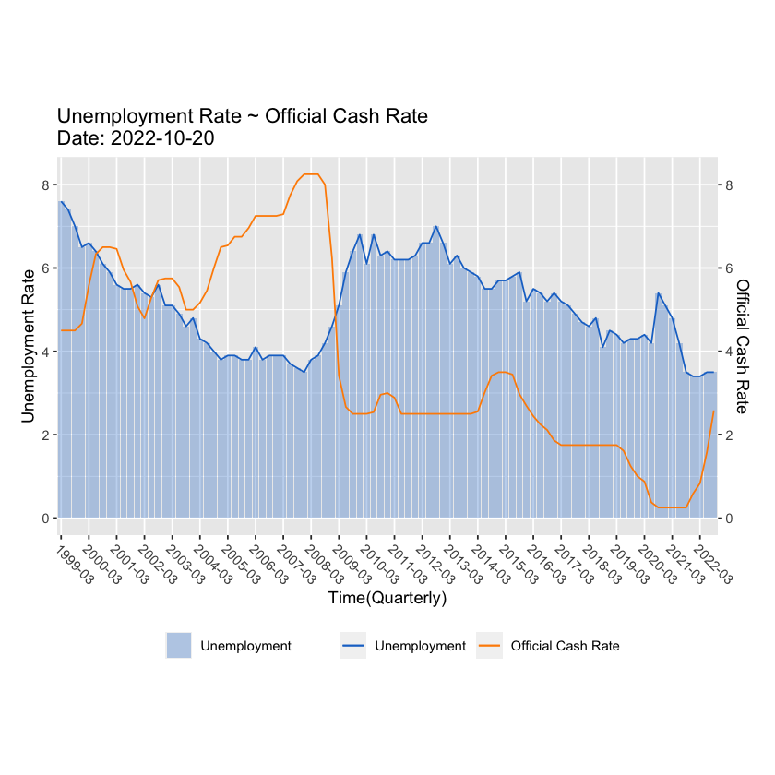
OCR VS. Unemployment Rate
In this chart, it is observable that as OCR increase, in a few months time, the unemployment rate has also increased.
Plot 1) x axis time (yyyy-mm) : y axis (OCR + (Labour force status))

Slide 16
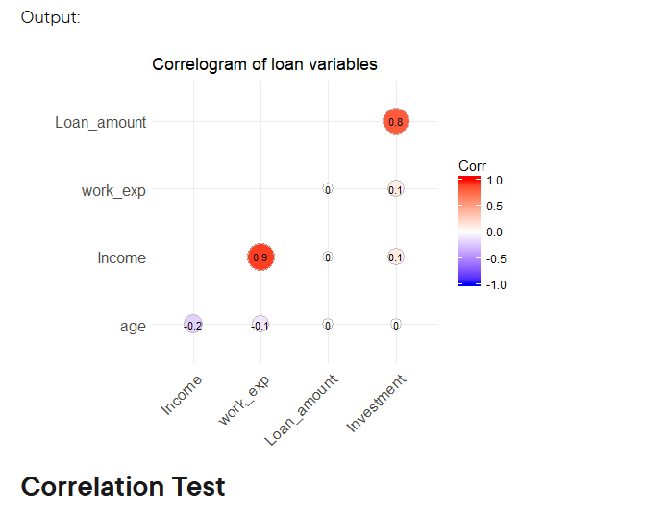
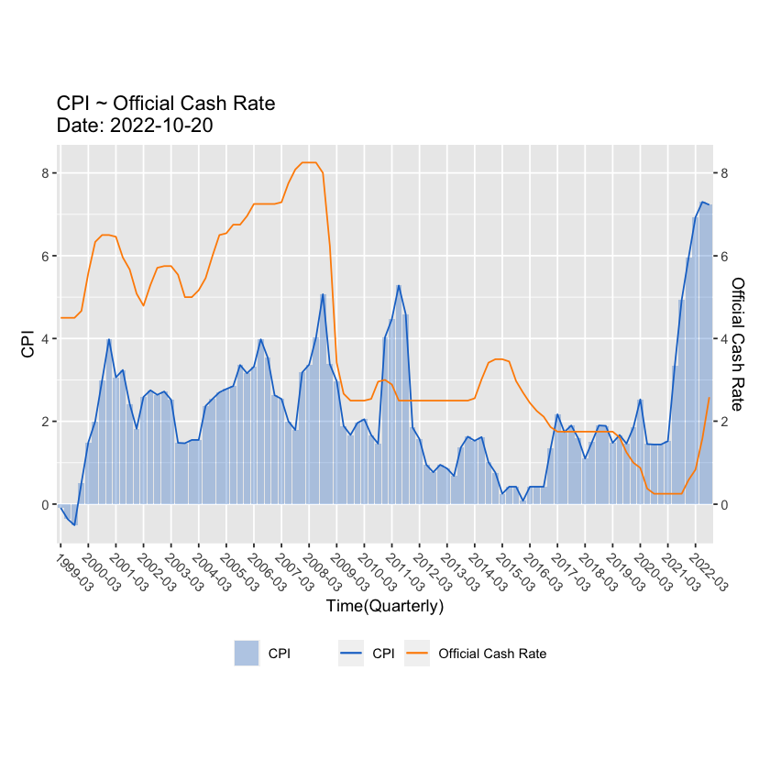
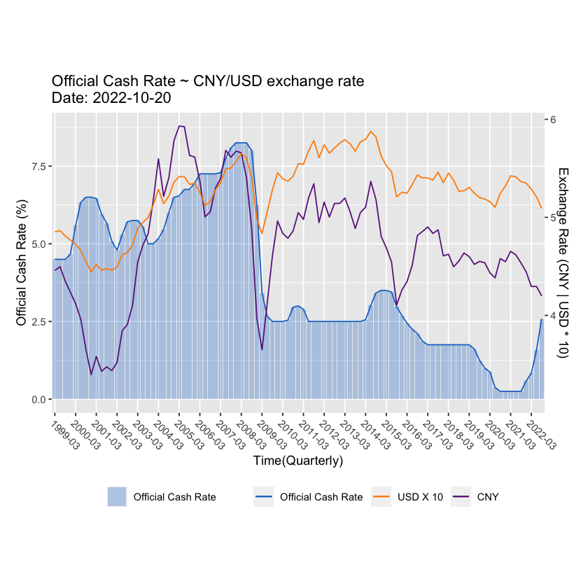
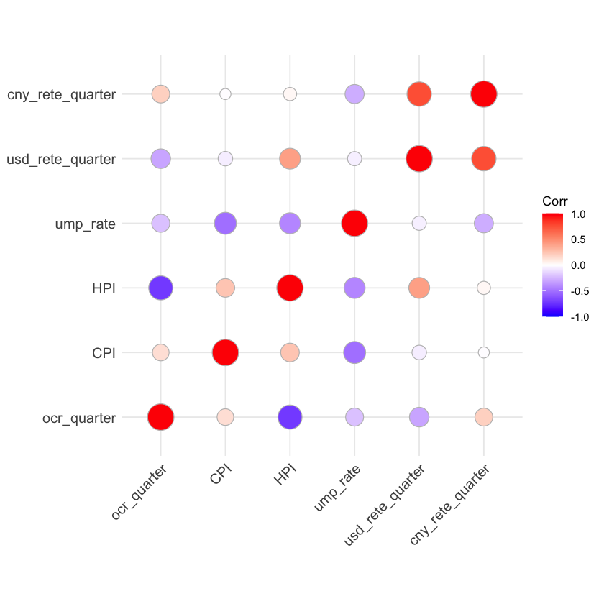
Charts Generated
3) Correlation between “OCR” and CPI
4) Correlation between “CPI” and HPI
5) Correlation between “OCR” and Exchange Rate NZD VS. USD
6) Correlation between “OCR” and CPI

Slide 17
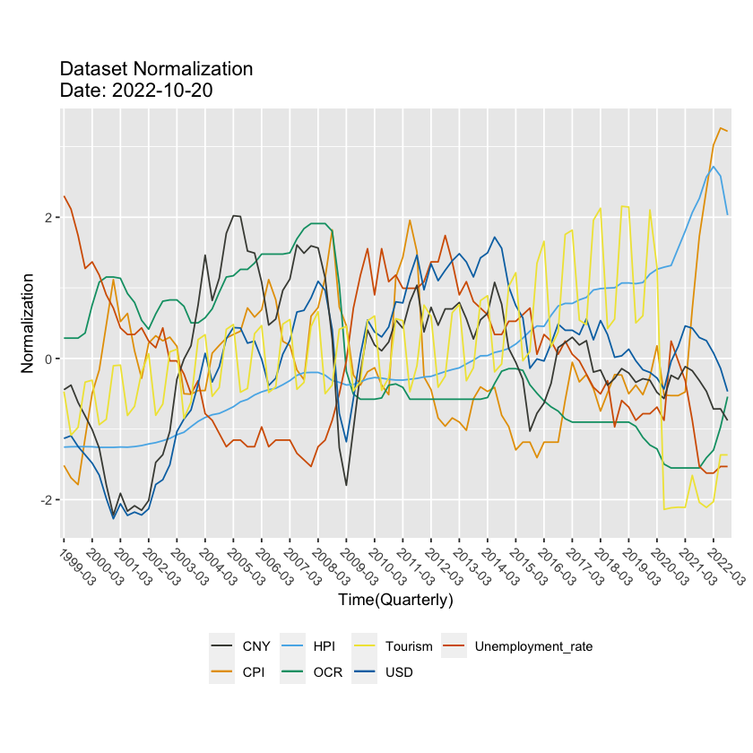
Conclusions
Based on the data we have collected as well as what subsequent plots generated based on that.
The following insights have been reviewed.
As New Zealand Reserve Bank sets its interest rate up, various business will have difficult of getting cheap loans for further development, therefore business activities have been reduced, which leads to increase of unemployment and reduction of general road traffic.
On the other hand, increase of Reserve Bank interest rate will attract oversea hot money for short term investment, therefore it is anticipated that exchange rate of New Zealand dollars VS. US dollar will go up. The high Reserve bank interest rate will lead to lower level of economic activities, hence in term of cargo freight statistics, general vehicle activities and tourism account, we have observed dropping in these activities.
However, Reserve Bank raise interest rate usually to combat high inflation rate (CPI), therefore, we should be expecting dropping of the CPI.
When the economic activities are low and unemployment rate is high
New Zealand government is under pressure to unleash new monetary policies to stimulate economy. Hence government usually resolve to lower reserve bank interest rate.
With low reserve bank interest rate, we have observed weak New Zealand dollars VS US dollars. Thus make export of our products cheaper, therefore attracts more oversea purchases, subsequently we should also be able to observe an increase of freight transportation activities, oversea passage flights.
To stimulate general economic growth, government usually initiate major infrastructural projects like major road works, etc. Hence it is also anticipated that general road construction activities are increasing.

